Slide 1
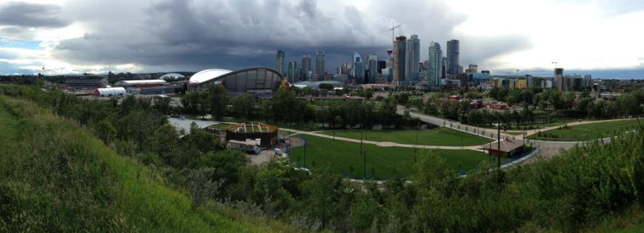





Flood Resilient Cities: the Blue-Green Advantage
Colin Thorne University of Nottingham and KCB/ESA
bluegreencities.ac.uk
EPSRC Grant EP/K013661/1

Slide 2
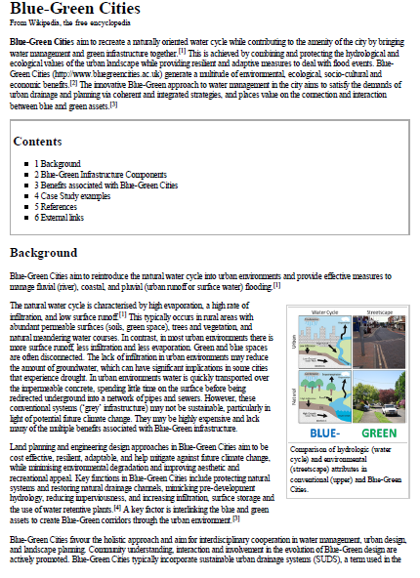
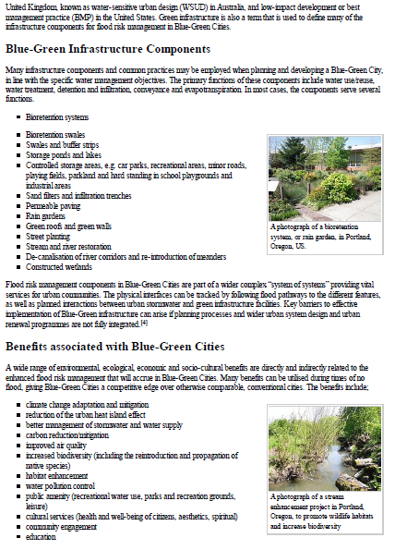
http://en.wikipedia.org/wiki/Blue-Green_Cities
Blue-Green Cities aim to recreate a naturally oriented water cycle while contributing to the amenity of the city by bringing together water management and green infrastructure ¹
Hoyer, J., Dickhaut, W., Kronawitter, L. and Weber B. 2011. Water Sensitive Urban Design. Jovis, University of Hamburg.

Slide 3
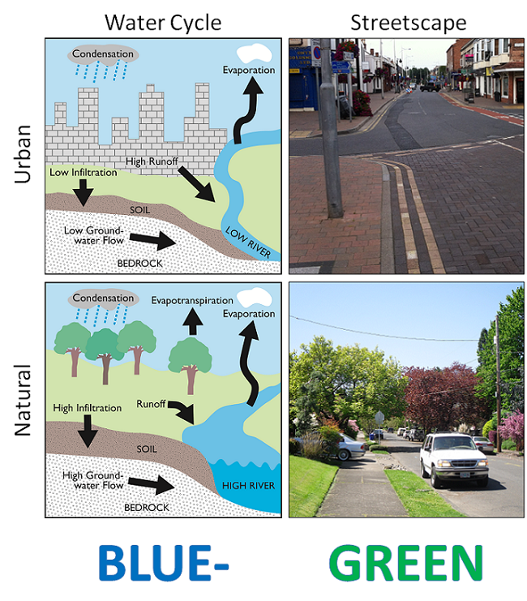

Slide 4
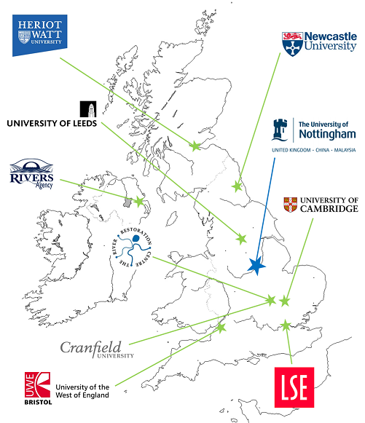


Slide 5


Slide 6
Blue-Green Cities Research Approach
Model Existing Flood Risk Management
Understand Citizens’ Behaviours
Evaluate Multiple Flood Risk Benefits
City Authority and Community Communications
Options for Hard/Soft Measures
Demonstration Case Study

Slide 7
City Authority
and Community Communications

Slide 8
Initiation
Scoping and Context
Develop Shared Vision
Implement
Capture
Leaning and Action Alliance (LAA)
City Authority
and Community Communications
Adapted from Ashley et al., (2011)

Slide 9
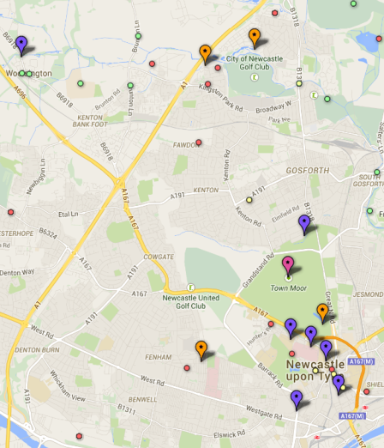
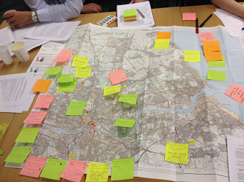
Inventory of EXISTING Blue-Green Infrastructure
1. Delivered
2. Possible to influence
3. Visionary

Slide 10
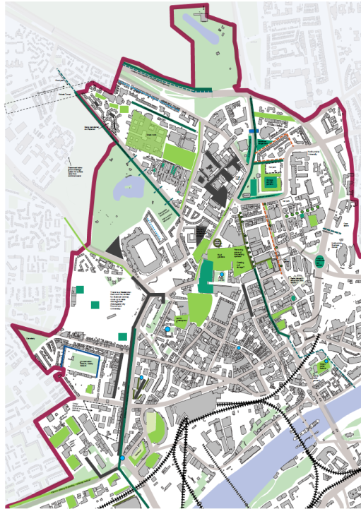
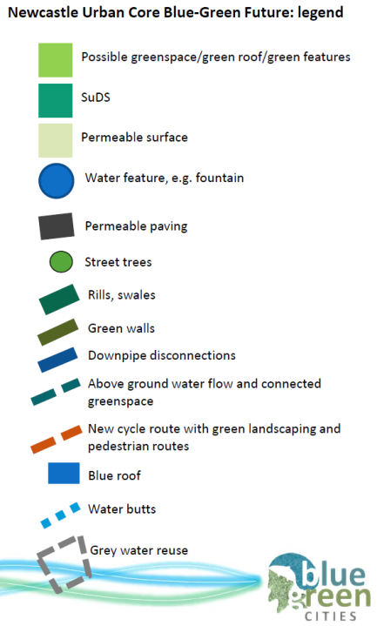
Newcastle urban core – Blue-Green Future

Slide 11
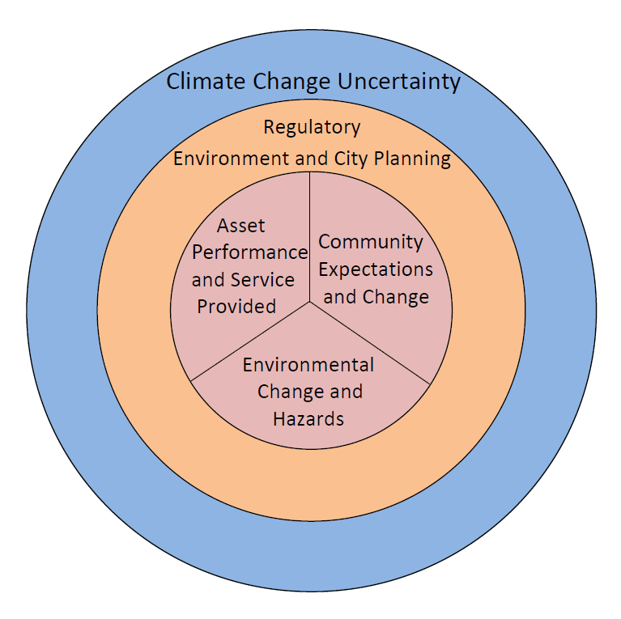
Relative Dominant Uncertainties
Thorne et al. 2015. "Overcoming uncertainty and barriers to adoption of blue-green infrastructure for urban flood risk management" Journal of Flood Risk Management (in press).

Slide 12
Understanding Citizens’ Behaviours

Slide 13
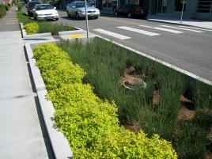
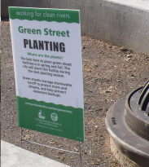

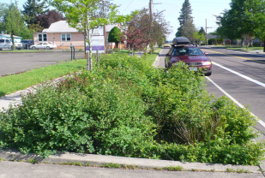
Citizens’ views, beliefs and values – most people:
+ Like green spaces and streets, and traffic calming
Have low awareness and understanding of Blue-Green Infrastructure
Don’t want to pay more for Blue-Green Infrastructure
Don’t like the plants used in Bioswales (culture/aesthetics)
Local people and communities:
are the local experts - with useful local knowledge
value Blue-Green Infrastructure once they understand it
need to cooperate in maintaining BGI over the long-term
need to feel ownership to make BGI solutions work
must be engaged with prior to implementation of BGI

Slide 14
Model Existing Flood Risk Management

Slide 15
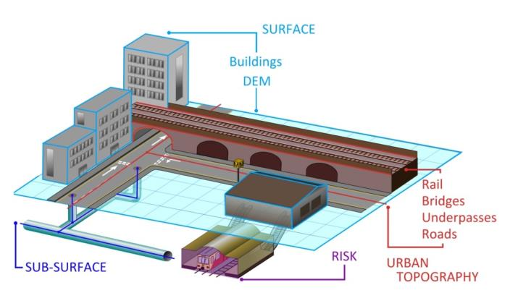
CityCAT: Combined sewer and surface water flood model
couples surface + subsurface drainage networks
models flooding due to:
rainfall + blocked sewers + sewer surcharge

Slide 16
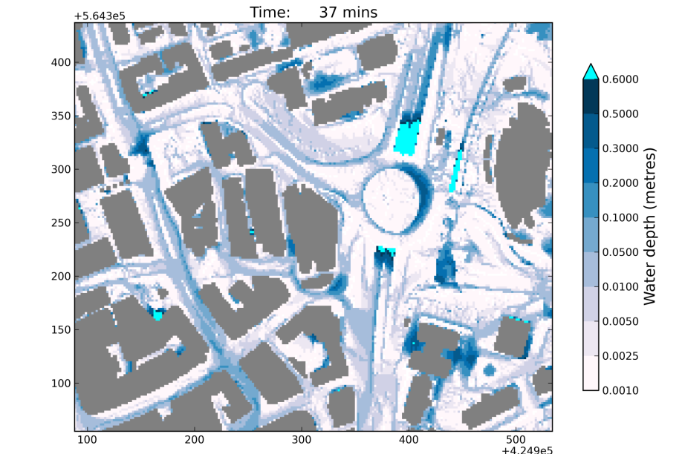
Flooded intersection paralyses rush hour traffic

Slide 17
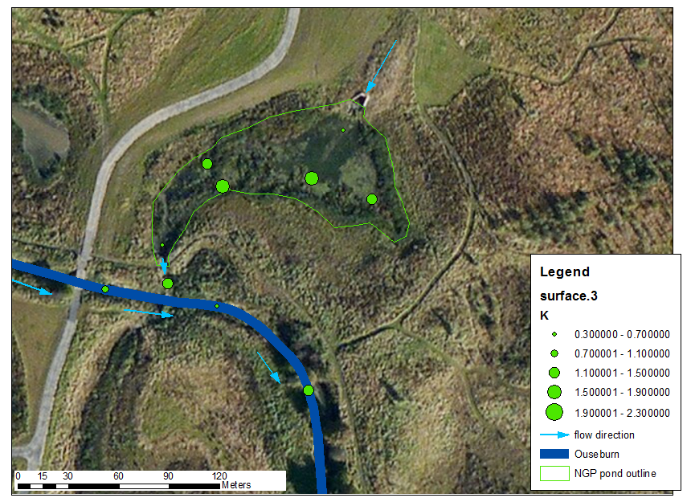
BGI manages water quality as well as quantity
Initial pollutant levels mapped using GIS

Slide 18
Options for Hard/Soft Measures

Slide 19
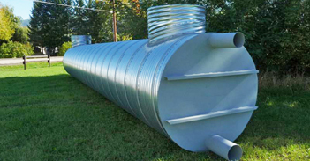
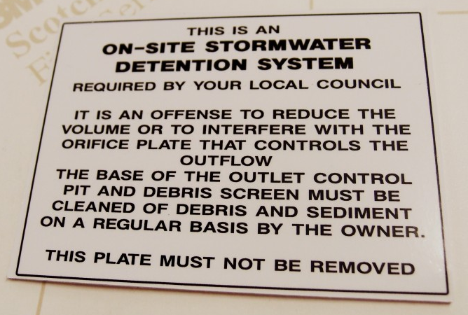
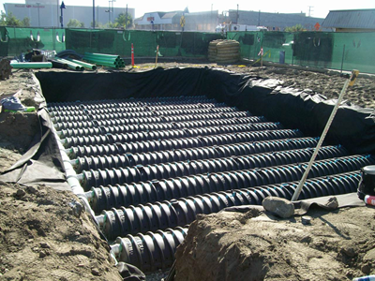
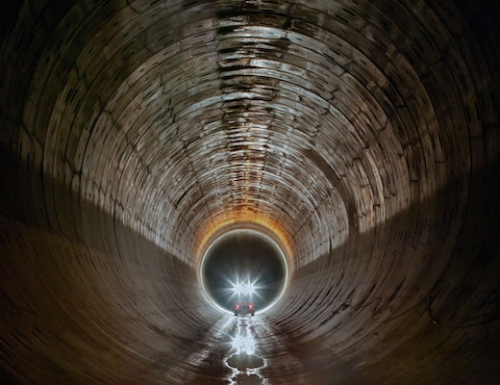
Grey Options: Environmental performance
Source www.nwl.co.uk

Slide 20
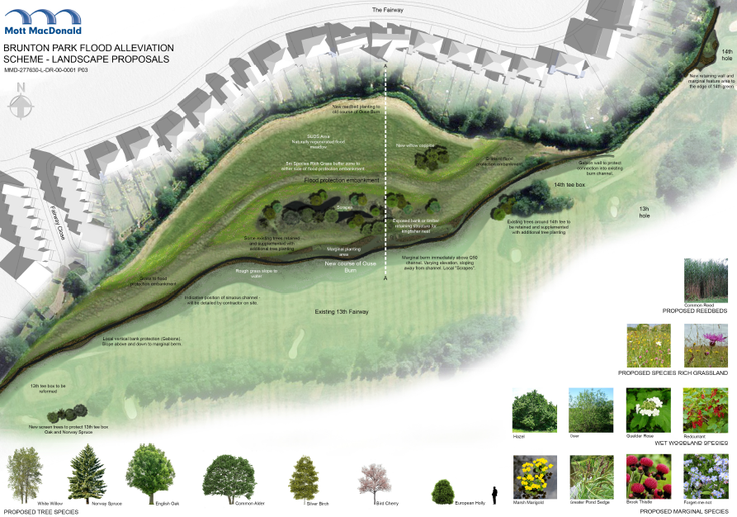
Blue-Green Options: Environmental performance

Slide 21
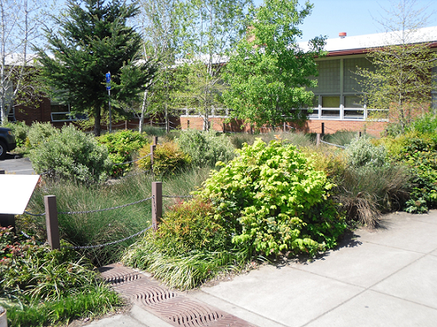
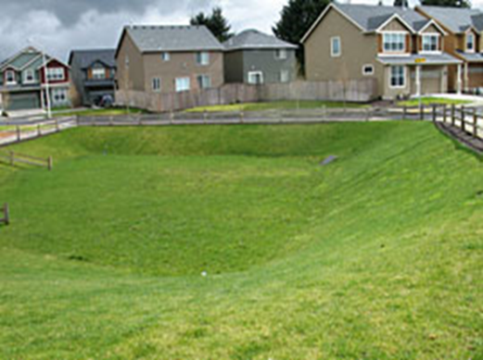
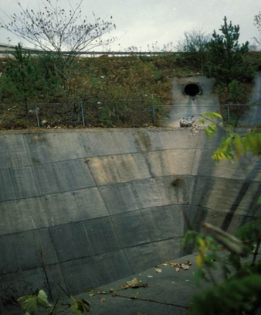
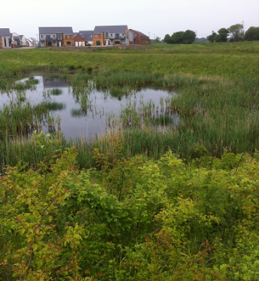
Grey-Green Options: Social performance
Storm water as a resource
(not just a hazard)
Blue-Green Options: Social performance

Slide 22
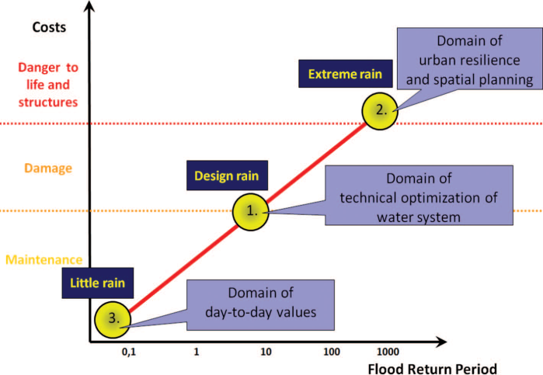
Blue
Condition
If extreme flooding occurs BGI facilitates managed urban conveyance and storage.
Blue-Green infrastructure provides required level of service for flood defence.
Green infrastructure and spaces used on a daily basis by communities and ecosystems.
Green
Condition
Designing for Exceedance
+ Designing for non-flood conditions
= Benefits 24/7, 365 days a year……
Fratini et al.,(2012) Three Points Approach (3PA) for urban flood risk management.

Slide 23
Evaluate Multiple Flood Risk Benefits

Slide 24
Direct Damages = £129 M Indirect Damages = £102 M
Trade and Business sectors most affected

Slide 25
It took about 14 months for small businesses to recover

Slide 26


BeST(Benefits of SuDS Tool)
W045d BeST–User Manual
Release version
1 July 2015
https://ciria.sharefile.com/share#view/9e79a9ddac8044b2

Slide 27
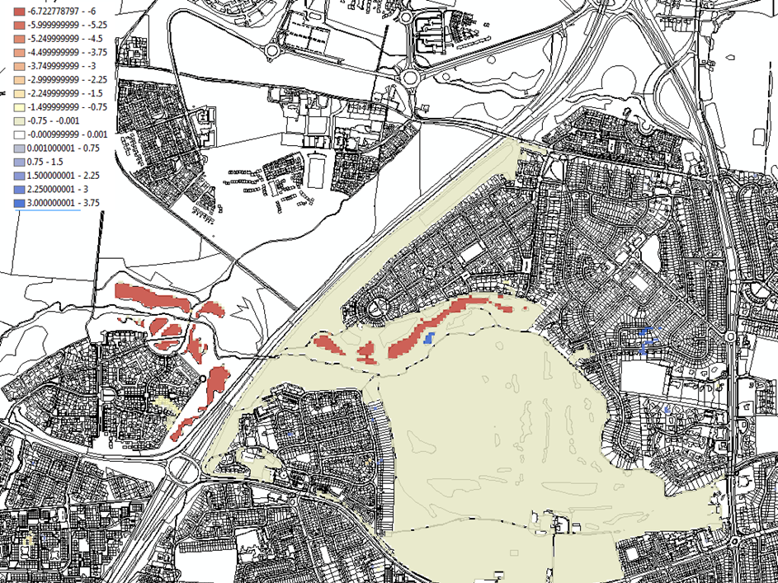
Q-GIS Benefit Mapping Software
The GIS creates benefit layers based on:
Benefit profile: contextualised values related to ‘who benefits’
Benefit mapping: spatial extent and distribution
Benefit dependency: complimentary and exclusivity of impacts
Example: flood mitigation and carbon sequestration benefits, Brunton Park BGI, Newcastle

Slide 28
Demonstration Case Study

Slide 29


Clean Water For All 2014
http://www.bluegreencities.ac.uk/bluegreencities/research/clean-water-for-all.aspx

Slide 30
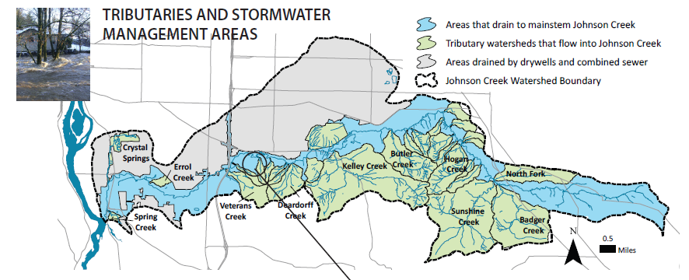
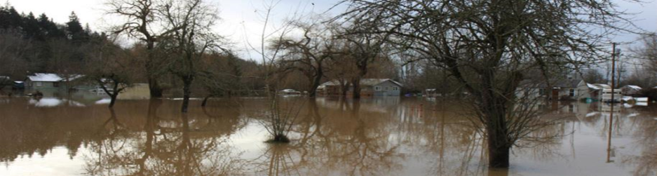
Johnson Creek, Portland, Oregon, USA
Johnson Creek State of the Watershed Report 2012

Slide 31
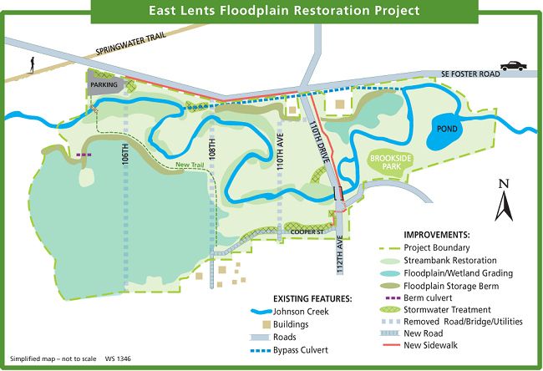
63 Flood prone properties acquired through Willing Sellers program

Slide 32
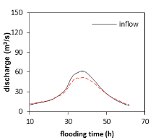
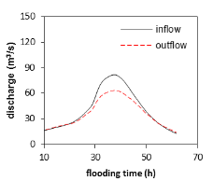
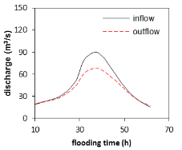
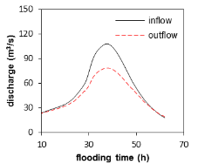
10 year
50 year
Flood peak reduction benefits are strong and increase for longer return period events
100 year
500 year

Slide 33
25 to 40% incoming
sediment load is deposited in
restored floodplain
Sediment deposition

Slide 34
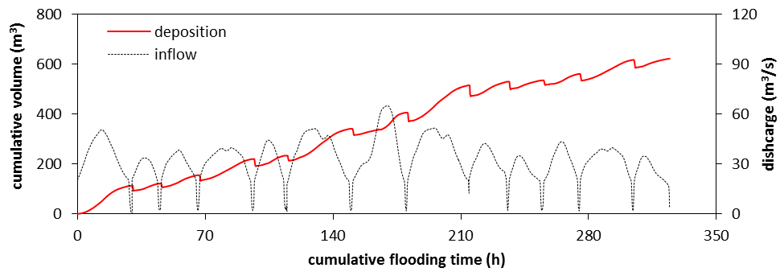
Sediment retention benefits are substantial and accrue through time

Slide 35
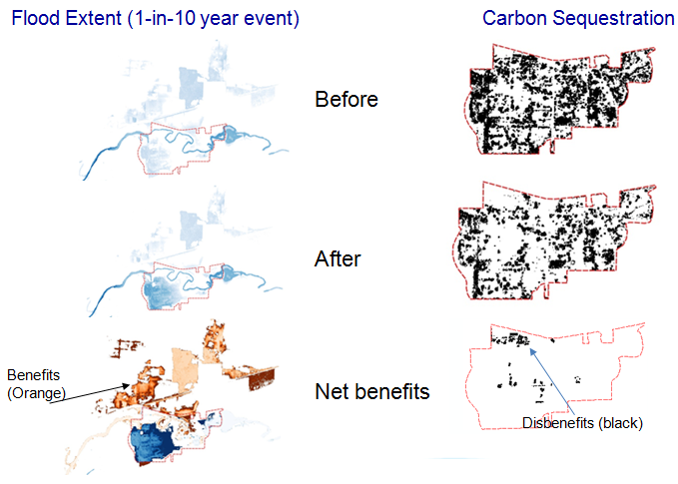
GIS used to map, quantify and value benefits
Reconstructing floodplain has resulted in some temporary disbenefits due mostly to loss of trees
But reconstructed floodplain yields net benefits when flooded, flooded beyond design capacity or not flooded at all.

Slide 36

“what is required is a fundamental change in how we view flood management, from flood defence where we protect ourselves to one of resilience, living with and making space for water and the opportunity to get “more from less” by seeing all forms of water as providing multiple benefits.”
Commission of Inquiry into flood resilience of the future titled ‘Living with water’, March 2015. All Party Group for Excellence in the Built Environment, House of Commons, London SW1A 0AA: p. 32, para. 3.
Take Home Message

Slide 37
The research is being conducted as part of the Blue-Green Cities Research Consortium with support from the:
  UK Engineering and Physical Sciences Research Council
  Northern Ireland Rivers Agency
  Environment Agency of England
  National Science Foundation, USA
  City of Portland Bureau of Environmental Services, USA
bluegreencities.ac.uk
EPSRC Grant EP/K013661/1

